Slide 1
Identification Analysis and Calibration of Various Traffic Factor
By M.Saeem Ansari (2019430001)
Faculty Incharge: Dr. Prof. Radha Shankarmani

Slide 2
Introduction
The aim of this research is to identify analyze and calibrate the various factors associated with traffic.
With the advancements in computational technology over the last few decades, traffic analysis and simulation has become popular among researchers.
The findings showed that we can group factors associated to traffic into three cluster based on delay its caused and distance between the source and destination.

Slide 3
Motivation
As quantity of vehicles are increasing in our country but we don't have corresponding infrastructure to support it.
So in order to reach destination on time we need to have accurate traffic analysis.

Slide 4
Gap Identified
Already present traffic prediction systems like google map have following GAPs :
Does not give accurate result google map works on no. of android devices present in specific route and how fast they are moving.
Google map does not show what are the reason or factor of traffic.

Slide 5
Objectives
To identify various factors that affects road traffic.
To collect traffic data from google map.
To calibrate or measure strength of various traffic affecting factors.
To find the probability of each factor and their delay.
Categorized factors according to its severity and frequency

Slide 6
Methodology
Data collection
Data preprocessing
Clustering
Probability calculation

Slide 7
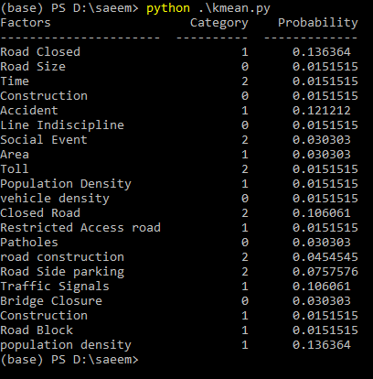
Result

Slide 8
Conclusion
Factors identified
Categorized into 3 categories
Calculate probability of each factor

